Slide 1
Acceleration

Slide 2
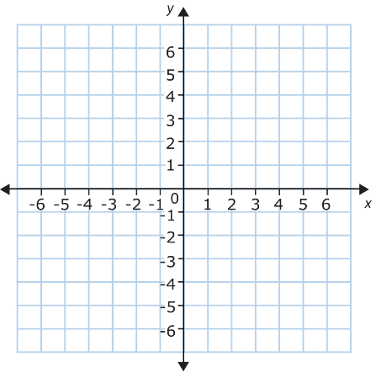
Sign Conventions
When working in one dimension (e.g. left-right, up-down, north-south), vectors are expressed as positive or negative numbers based on their direction.
This sign convention mirrors the axes you might draw on a graph:
Horizontally:
Right, east, and forwards are positive
Left, west, and backwards are negative
Vertically:
Up and north are positive
Down and south are negative
left (-)
right (+)
backwards (-)
forwards (+)
W (-)
E (+)
up (+)
N (+)
down (-)
S (-)

Slide 3
Change in Velocity
One vector can be subtracted from another by adding its negative (i.e. equal magnitude, opposite direction).
For example, to find an object’s change in velocity:
$$Δv=v−u \\ Δv=v+\left(−u\right)$$
The symbol Δ (Greek capital letter delta) is frequently used to represent change.
Δv must be given a direction: since it is the sum of two vectors, it is itself a vector.

Slide 4
Example #1
Sam walks at 5.00 m s⁻¹ west then turns around and walks at 3.00 m s⁻¹ east. What was Sam’s change in velocity?
$Δv=v−u$
$v=3.00 \text{m} {\text{s}}^{−1} \text{east}=3.00 \text{m} {\text{s}}^{−1}$ $u=5.00 \text{m} {\text{s}}^{−1} \text{west}=−5.00 \text{m} {\text{s}}^{−1}$
$Δv=3.00−\left(−5.00\right)=3.00+5.00$
$Δv=8.00 \text{m} {\text{s}}^{−1}=8.00 \text{m} {\text{s}}^{−1} \text{east}$

Slide 5
Example #2
Kelly walks at 5.00 m s⁻¹ east then slows down and walks at 3.00 m s⁻¹ east. What was Kelly’s change in velocity?
$Δv=v−u$
$v=3.00 \text{m} {\text{s}}^{−1} \text{east}=3.00 \text{m} {\text{s}}^{−1}$ $u=5.00 \text{m} {\text{s}}^{−1} \text{east}=5.00 \text{m} {\text{s}}^{−1}$
$Δv=3.00−5.00$
$Δv=−2.00 \text{m} {\text{s}}^{−1}=2.00 \text{m} {\text{s}}^{−1} \text{west}$

Slide 6
Acceleration
Acceleration (a) is the rate of change of velocity.
$$a_{\text{av}}=\frac{Δv}{t}=\frac{v−u}{t}$$
It is measured in metres per second per second, i.e. metres per second squared (m s⁻²).
It is a vector quantity; its direction is based on the direction of the change in velocity.
Notes:
The word ‘acceleration’ can also be used to describe change in speed, but in physics contexts you should assume it is referring to change in velocity unless told otherwise.

Slide 7
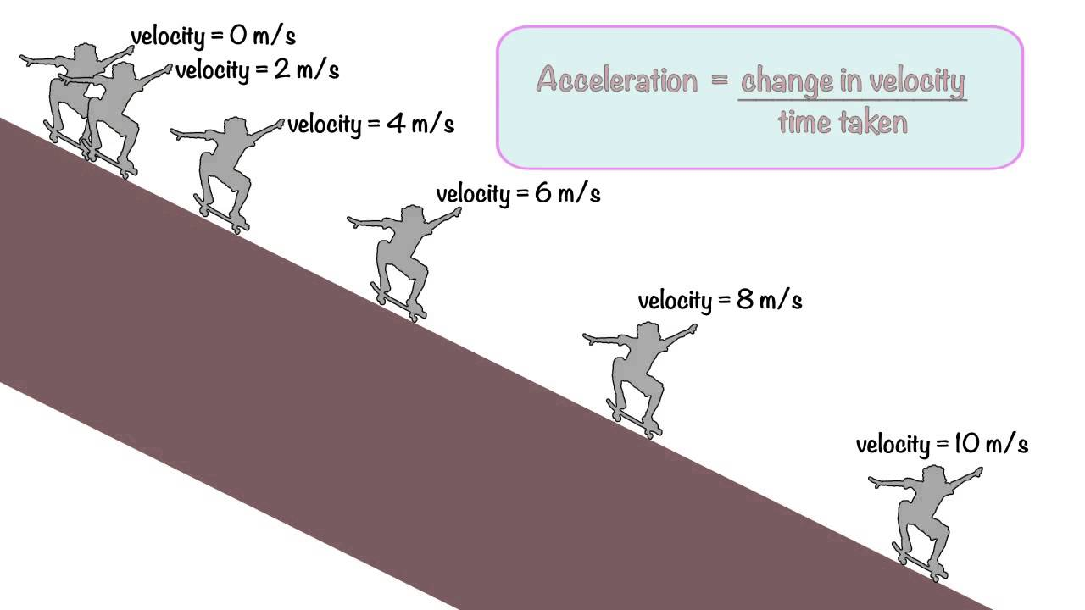
Acceleration
Consider the skater in the diagram. Their velocity changes by 2 m s⁻¹ down the ramp each second.
This means that their acceleration is 2 m s⁻² down the ramp.
0 s
1 s
2 s
3 s
4 s
5 s

Slide 8
Acceleration
Consider the skater in the diagram.
According to our sign convention, the skater’s velocity changes by -1 m s⁻¹ each second.
This means that their acceleration is -1 m s⁻², i.e. 1 m s⁻² to the left.
A negative acceleration like this can mean that the object is slowing down in the positive direction or that it is speeding up in the negative direction.
v = 4 m s⁻¹
t = 0 s
v = 3 m s⁻¹
t = 1 s
v = 2 m s⁻¹
t = 2 s
v = 1 m s⁻¹
t = 3 s
v = 0 m s⁻¹
t = 4 s
left (-)
right (+)

Slide 9
Example #3
A bike is travelling at 4.0 m s⁻¹ west. It then turns a corner and begins to travel 3.0 m s⁻¹ north. It does this in 2.0 s. What is its change in velocity and its acceleration?
$Δv=v−u=v+\left(−u\right)$
$Δv=3.0 \text{m} {\text{s}}^{−1} \text{north}+\left(−4.0 \text{m} {\text{s}}^{−1} \text{west}\right)$ $Δv=3.0 \text{m} {\text{s}}^{−1} \text{north}+4.0 \text{m} {\text{s}}^{−1} \text{east}$
$\left|Δv\right|=\sqrt{{3.0}^{2}+{4.0}^{2}}=5.0$
$$θ=\tan^{−1}\left(\frac{4}{3}\right)=53.1°$$
$Δv=5.0 \text{m} {\text{s}}^{−1} \text{N} 53.1° \text{E} \left(\text{or} 5.0 \text{m} {\text{s}}^{−1} 53.1°\text{T}\right)$
4.0 m s⁻¹ east
3.0 m s⁻¹ north
θ
5.0 m s⁻¹

Slide 10
Example #3
A bike is travelling at 4.0 m s⁻¹ west. It then turns a corner and begins to travel 3.0 m s⁻¹ north. It does this in 2.0 s. What is its change in velocity and its acceleration?
$Δv=5.0 \text{m} {\text{s}}^{−1} \text{N} 53.1° \text{E} \left(\text{or} 5.0 \text{m} {\text{s}}^{−1} 53.1°\text{T}\right)$
$$a_{\text{av}}=\frac{Δv}{t}=\frac{5.0}{2}$$
$$a_{\text{av}}=2.5 \text{m} {\text{s}}^{−2} \text{N} 53.1° \text{E} \left(\text{or} 2.5 \text{m} {\text{s}}^{−2} 53.1°\text{T}\right)$$
4.0 m s⁻¹ east
3.0 m s⁻¹ north
53.1°
5.0 m s⁻¹

Slide 11
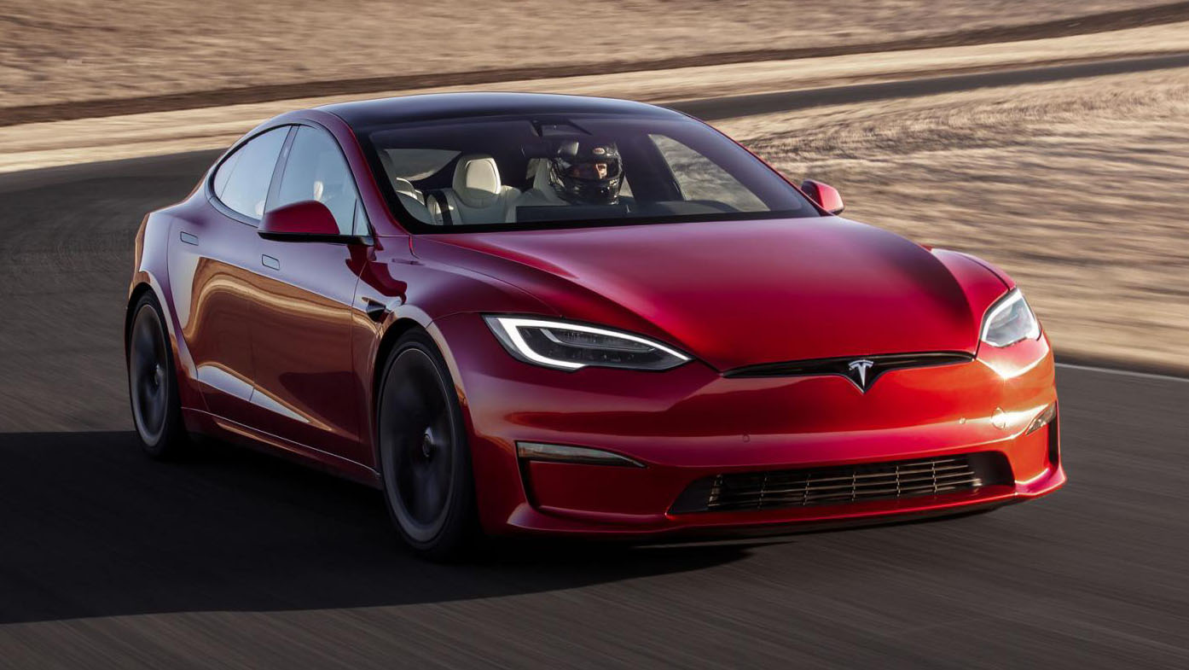
Example #4
A common measure of a car’s acceleration is how quickly it can reach 60 miles per hour (96.56 km h⁻¹) from a standstill. The Tesla Model S Plaid can reach this speed in just 1.98 s, making it one of the fastest accelerating cars in the world. Calculate the average acceleration (in m s⁻²) required to achieve this.
$$v=96.56 \text{km} {\text{h}}^{−1} \text{forwards} \\ =26.82 \text{m} {\text{s}}^{−1} \text{forwards}$$
$$u=0 \text{m} {\text{s}}^{−1}$$
$$t=1.98 \text{s}$$
$$a_{\text{av}}=\frac{v−u}{t}=13.5 \text{m} {\text{s}}^{−2} \text{forwards}$$
Notes:
Plaid is pronounced ‘plad’ for some reason. I blame Gaelic.

Slide 12
Example #4
If this acceleration can be maintained, how long will it take the Model S Plaid to reach its top speed of 348 km h⁻¹ from a standstill?
$$a=13.5 \text{m} {\text{s}}^{−2} \text{forwards}$$
$$a=\frac{v−u}{t} ∴t=\frac{v−u}{a}$$
$$v=348 \text{km} {\text{h}}^{−1} \text{forwards} \\ =96.67 \text{m} {\text{s}}^{−1} \text{forwards}$$
$$u=0 \text{m} {\text{s}}^{−1}$$
$$t=\frac{96.67}{13.55}=7.13 \text{s}$$

